Slide 1
IoT Based Farmer Helper
Review – 1
Team Members:
Thameemul Ansari U – 22MIS1140
Shirish S – 22MIS1121

Slide 2
Problem Statement
Farmers play a vital role in the economy, yet they face major challenges in accessing accurate and timely agricultural information. Most existing digital advisory platforms depend on smartphones and uninterrupted internet connectivity, which is unreliable in rural and remote areas. Language barriers further reduce adoption, as many farmers are not comfortable with English or mainstream languages used in applications.
Low digital literacy makes complex mobile apps difficult to operate, limiting effective usage. Moreover, essential data such as weather forecasts, market prices, and crop advisories are often generic and not tailored to the farmer’s exact location or crop condition. Cloud-based AI systems introduce latency, increase operational costs, and raise serious concerns regarding data privacy. Therefore, there is a strong need for a simple, low-cost, language-independent, and edge-based solution that works even with minimal internet access.

Slide 3
Components Used
Hardware Components
Raspberry Pi:
Serves as the edge computing unit for on-device AI processing and system control.
Microphone:
Captures voice queries from farmers in any local language.
Push Button:
Enables simple interaction without complex UI.
Speaker:
Provides voice-based responses for easy understanding.
Display Screen:
Shows summarised text output, weather details, or market prices.

Slide 4
Software & Technologies
Lightweight Edge AI Model:
Performs reasoning and response generation locally.
Speech-to-Text (STT):
Converts spoken queries into text on the device.
Text-to-Speech (TTS):
Converts AI responses back into natural voice.
Language Detection Module:
Automatically identifies the user’s language.
IoT APIs:
Fetches real-time weather and market price data.
Python Framework:
Integrates AI, IoT, and hardware modules.

Slide 5
Architecture & Research Gap
Existing Systems (Limitations)
Depend heavily on cloud servers and constant internet access.
Require smartphones and complex mobile applications.
Limited support for regional languages and dialects.
High response latency due to cloud processing.
Privacy concerns due to centralized data storage.
Proposed System (Our Contribution)
AI inference performed entirely on the edge device.
Language-independent voice interaction.
Minimal internet usage (only for essential IoT data).
Low-latency responses and enhanced privacy.
Designed for users with low digital literacy.

Slide 6
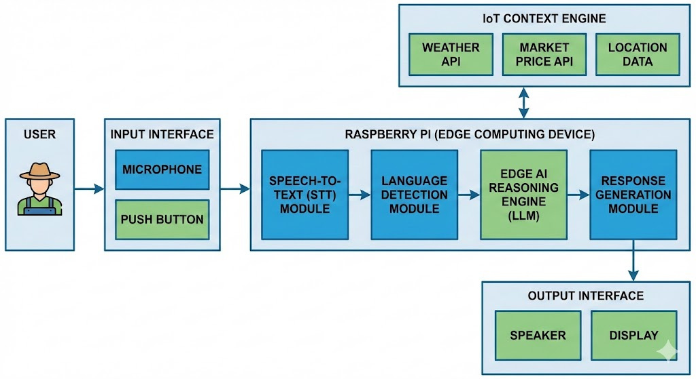

Slide 7
Expected Outcome
Operational Prototype:
A fully functional edge-based AI assistant for farmers.
Multilingual Support:
Accurate voice responses in native and regional languages.
Context-Aware Advice:
Personalized recommendations using weather and market data.
Low Latency:
Faster response compared to cloud-based systems.

Slide 8
Offline Capability:
Works with limited or intermittent internet access.
User-Friendly:
Simple button-based interaction for low-literacy users.
Scalable Solution:
Can be deployed across villages at low cost.
Social Impact:
Empowers farmers to make informed decisions

Slide 9
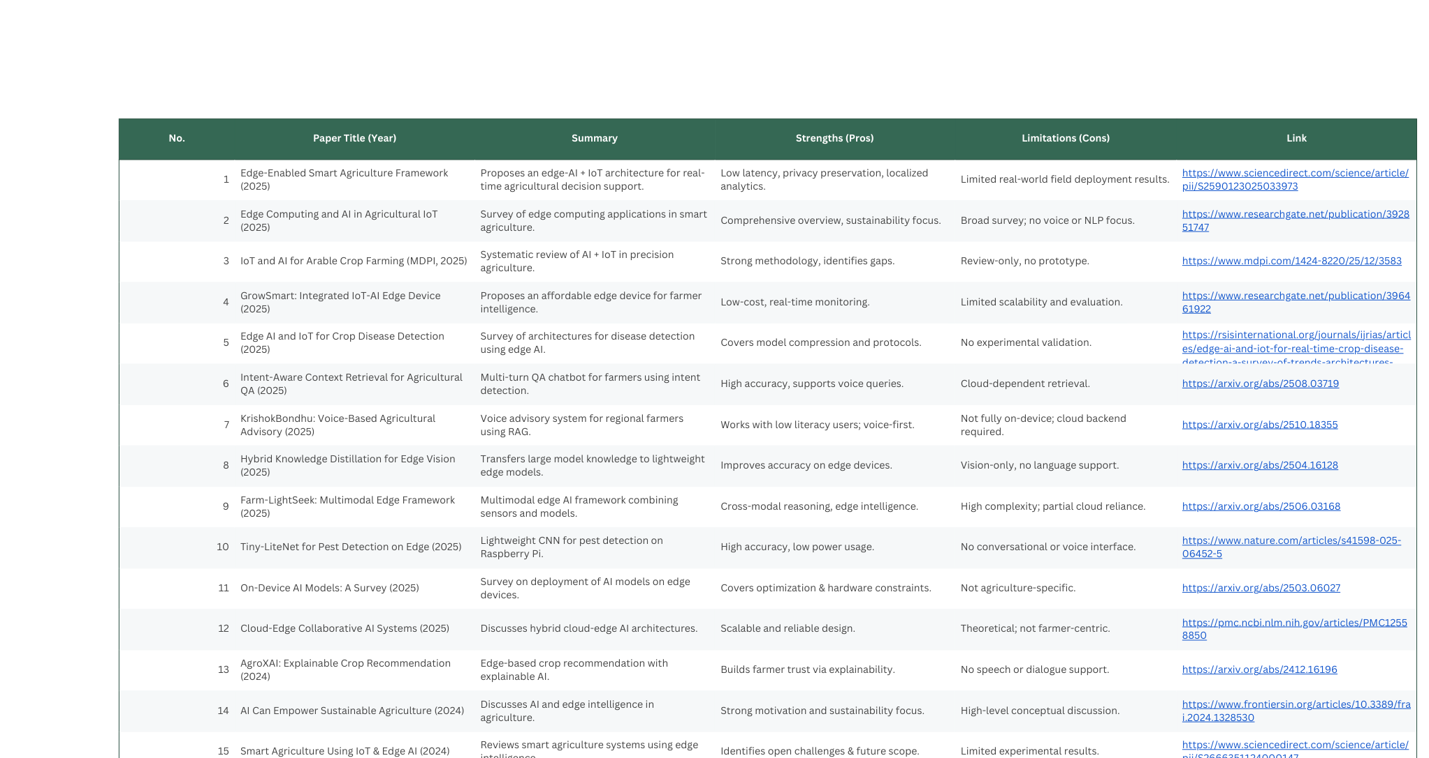
References

